Slide 1

Proactive Device Management Unleashed
Intune Advanced Analytics and Microsoft Copilot in Action

Slide 2


About “Joery Van den Bosch”
Focus
Certifications
Microsoft Intune Geek, Blogger
From
Hobbies
Modern Workplace Architect @ Arxus
Food, Whisky, Formula 1 & My Family
My Blog
Contact
Https://intunestuff.com
Joery@intunestuff.com
LinkedIn : https://www.linkedin.com/in/joery/

Slide 3







About “Maxime Guillemin”
Focus
Certifications
Microsoft Intune, MS Graph API & Automation
Microsoft 365 Certified: Endpoint Administrator Associate
Microsoft Certified: Azure Administrator Associate
Microsoft 365 Certified: Security Administrator Associate
From
Hobbies
Modern Workplace Architect @
Skiing , Scuba Diving & Blogging
My Blog
Contact
Https://cloudflow.be
mg@cloudflow.be

Slide 4
Agenda
Intune Advanced Analytics
Demo
Key takeaways:
Device Query with Copilot
Demo
Q&A

Slide 5

Who has used Intune Advanced Analytics
ⓘ Start presenting to display the poll results on this slide.

Slide 6
Intune Advanced Analytics
6
Device Scopes
Battery Health Report
Recourse performance Report
Enhanced Device Timeline
Anomaly Detection
Device Query
Notes:
Intune advanced analytics gives you deeper insights into your organization’s devices and apps, helping you take action to keep everything running smoothly. Instead of just seeing that an app crashed in a general report, for example, you can now pinpoint which specific devices had issues and when they occurred, making it much easier to troubleshoot and fix problems before they get out of hand.

Slide 7
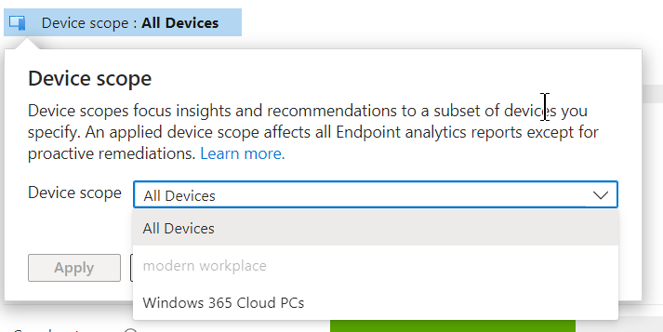
Device Scopes
Customized Reporting for Specific Device Groups
Focused Insights and Recommendations
Enhanced Management Efficiency
Improved Security and Compliance

Slide 8
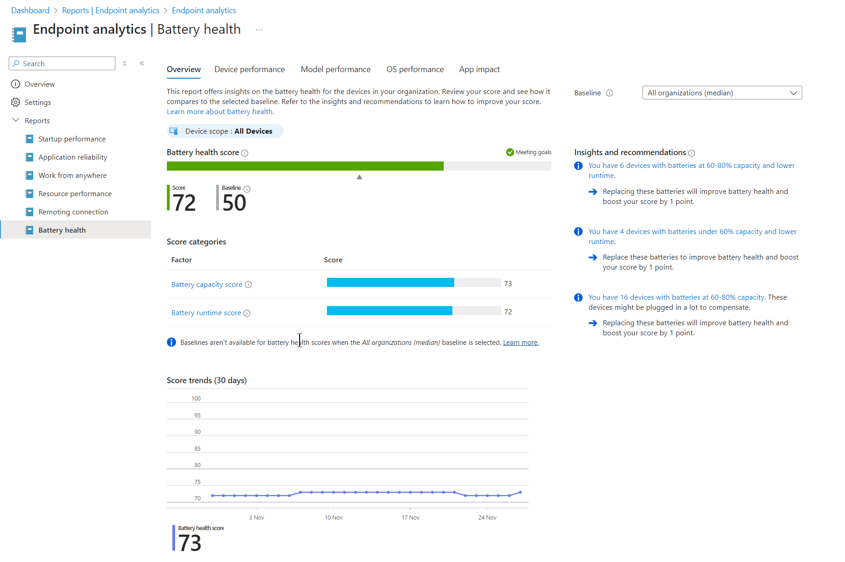
Battery Health Report
Easily Check How Your Device Batteries Are Doing
Find Battery Problems Before They Cause Trouble
Keep Your Team Working Smoothly
Save Money by Using Warranties Wisely
Make Smart Choices Using Real Data

Slide 9
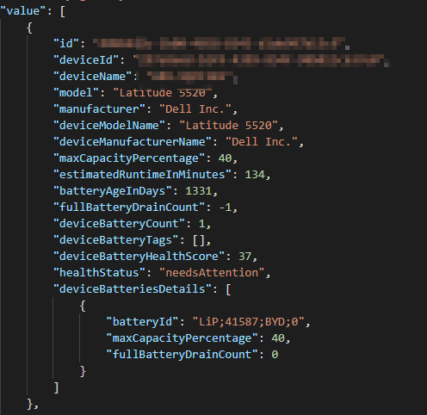
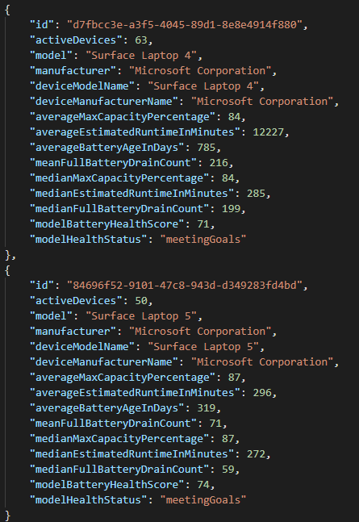
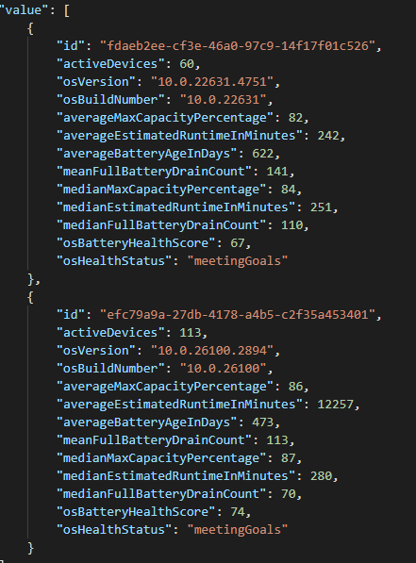
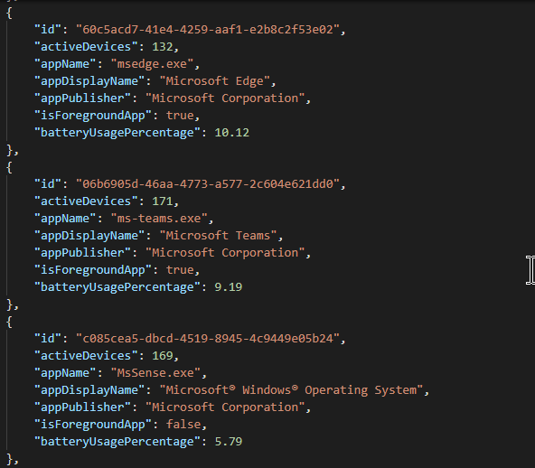

Battery Health MS Graph API
https://graph.microsoft.com/beta/deviceManagement/userExperienceAnalyticsBatteryHealthDevicePerformance
https://graph.microsoft.com/beta/deviceManagement/userExperienceAnalyticsBatteryHealthModelPerformance
https://graph.microsoft.com/beta/deviceManagement/userExperienceAnalyticsBatteryHealthOsPerformance
https://graph.microsoft.com/beta/deviceManagement/userExperienceAnalyticsBatteryHealthAppImpact

Slide 10
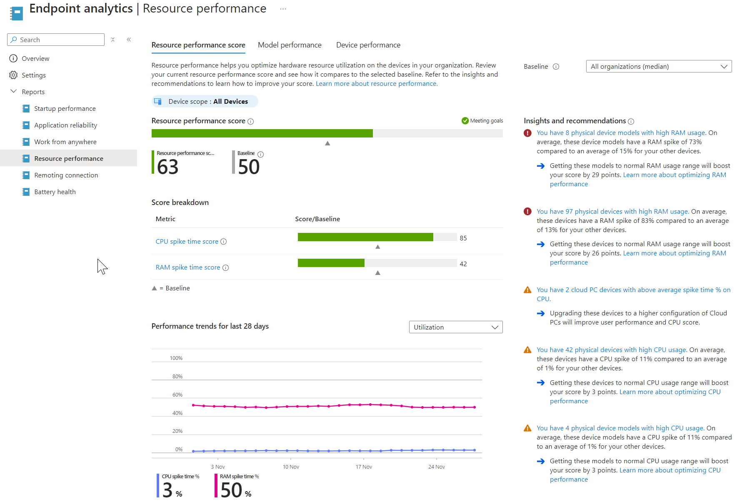
Resource Performance
Monitor Device Health Proactively
Anticipate and Resolve Performance Issues Early
Enhance User Experience and Efficiency
Optimize Hardware Upgrades and Budgeting

Slide 11
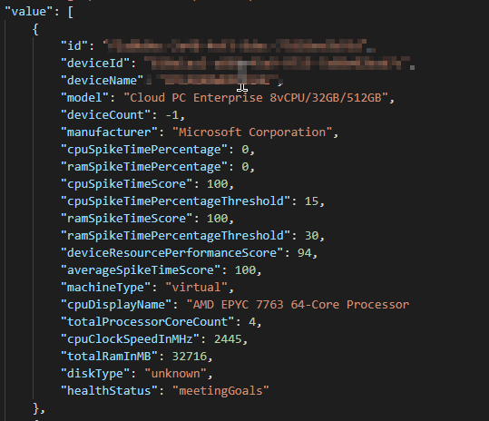
Resource Performance MS Graph API
https://graph.microsoft.com/beta/deviceManagement/userExperienceAnalyticsResourcePerformance

Slide 12
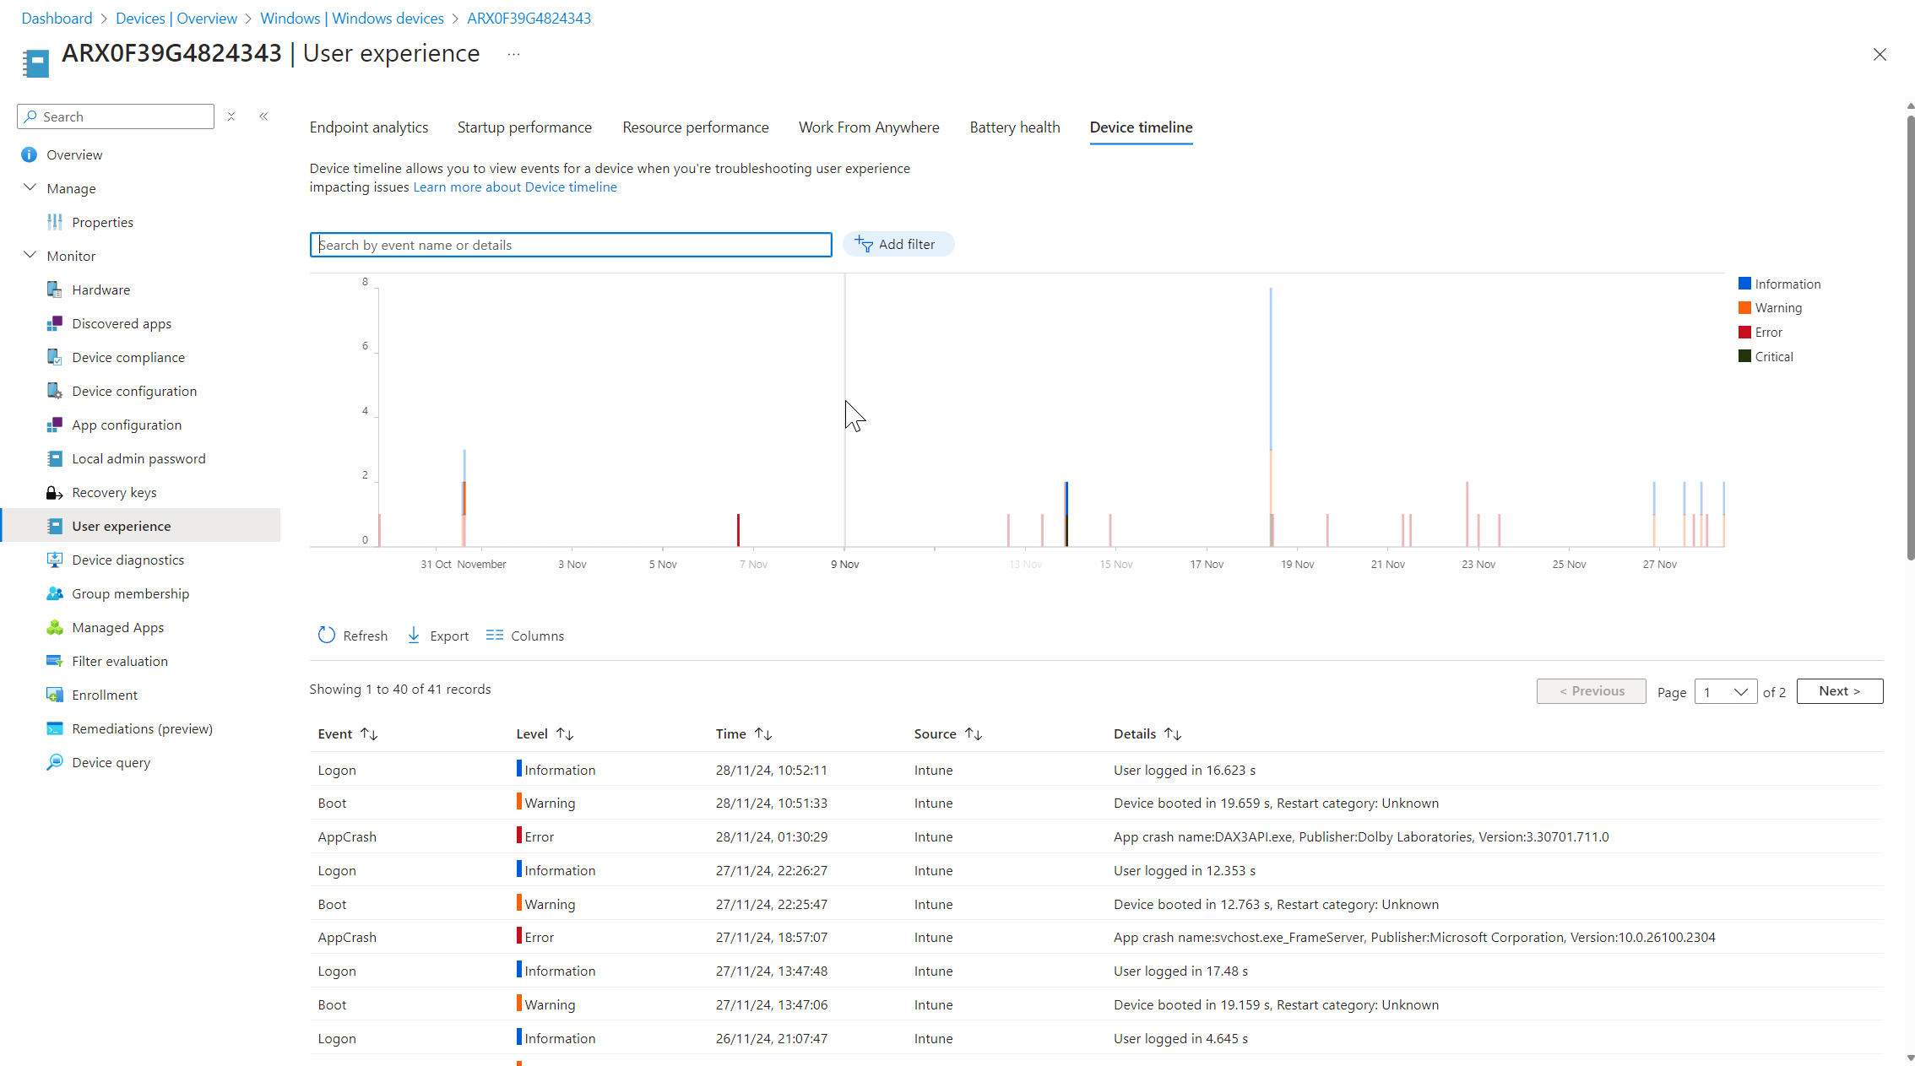
Enhanced Device Timeline
Comprehensive Event History for Devices
Application Performance Insights
Boot up Information
Logon Information
Streamlined Troubleshooting Process
Customizable Filters for Targeted Insight

Slide 13
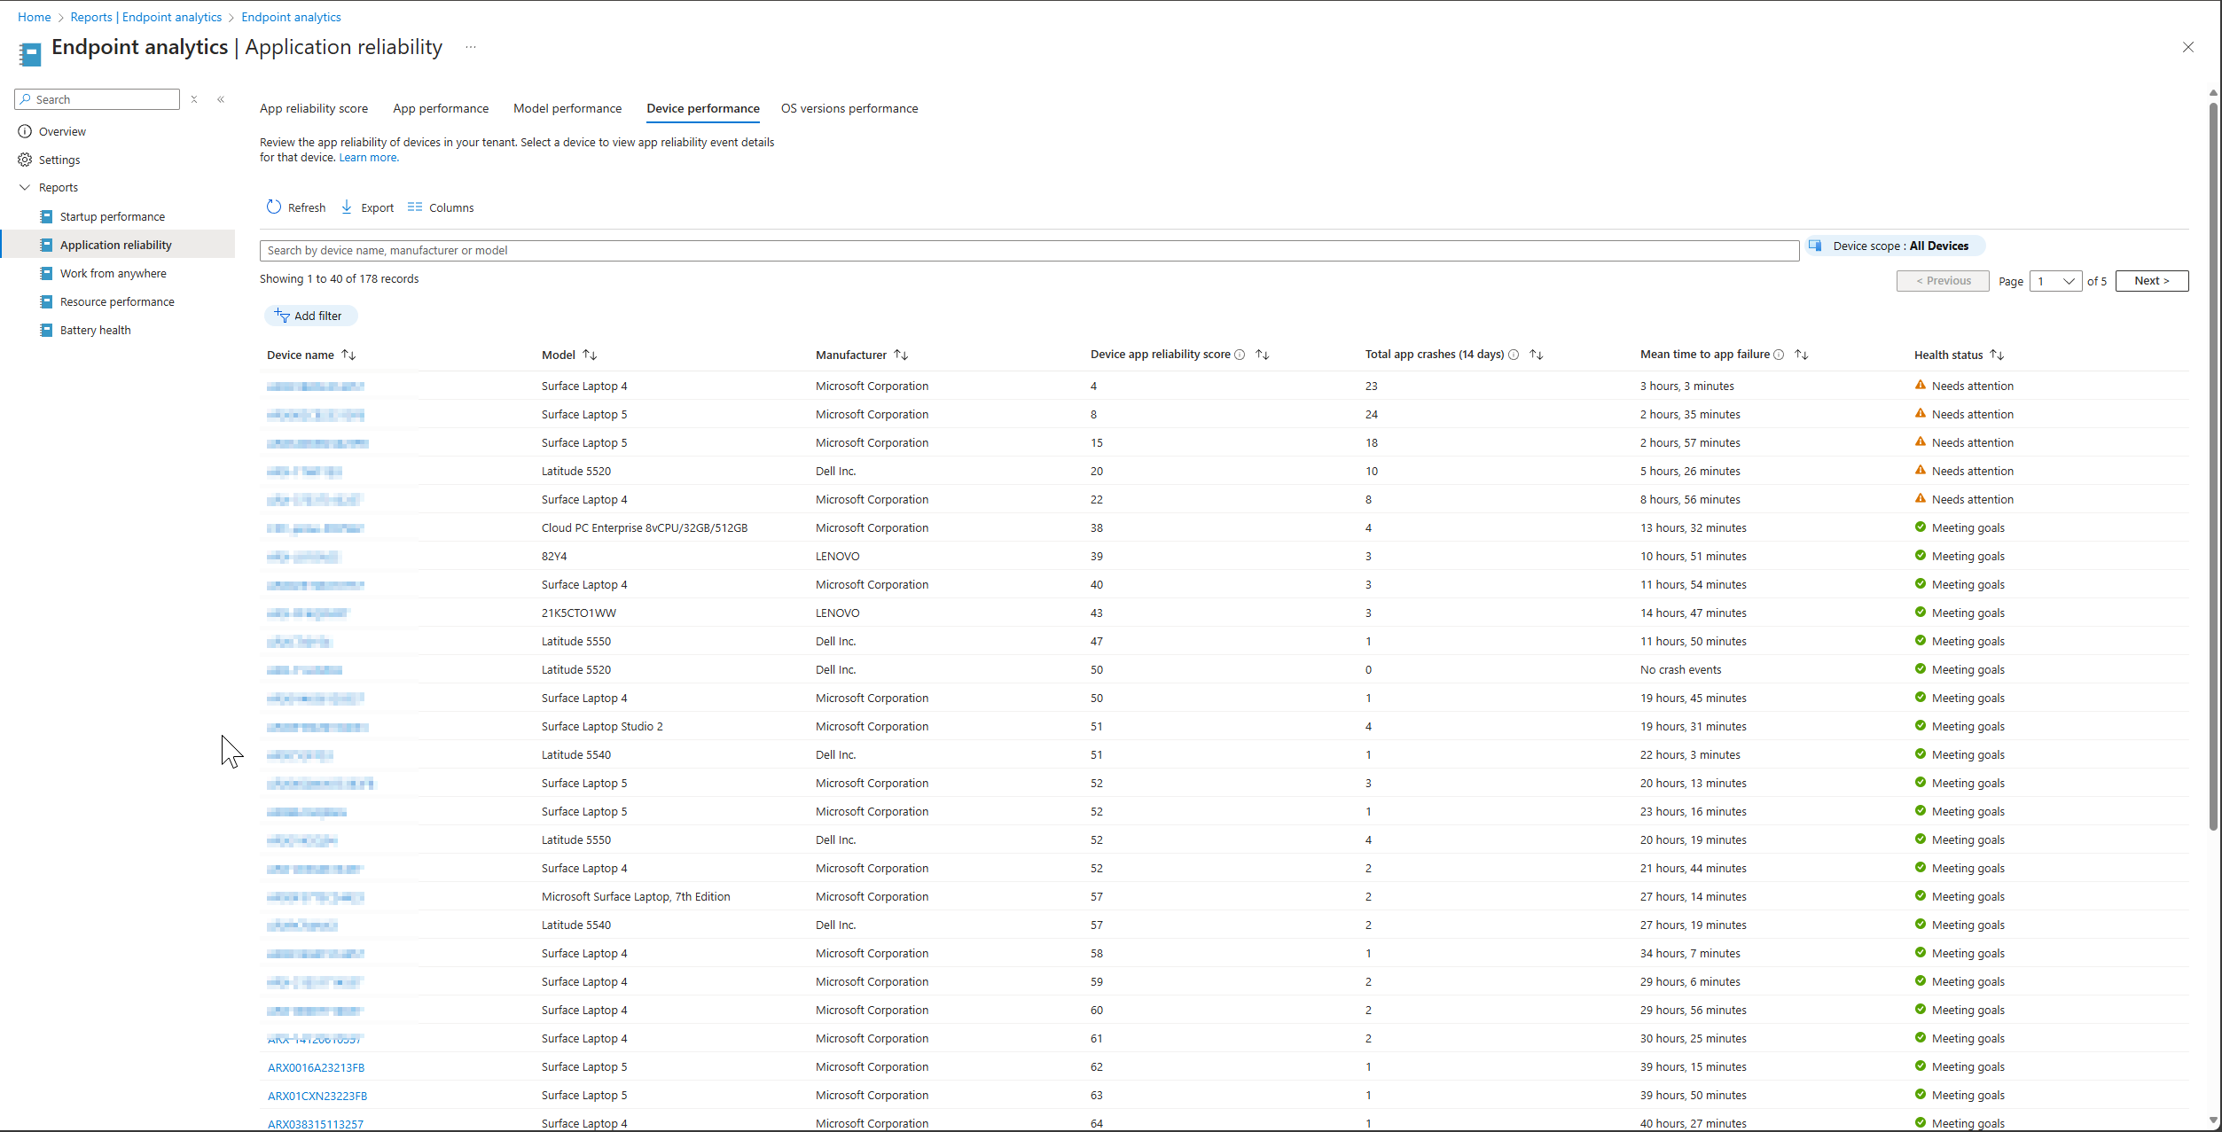
Enhanced Device Timeline

Slide 14
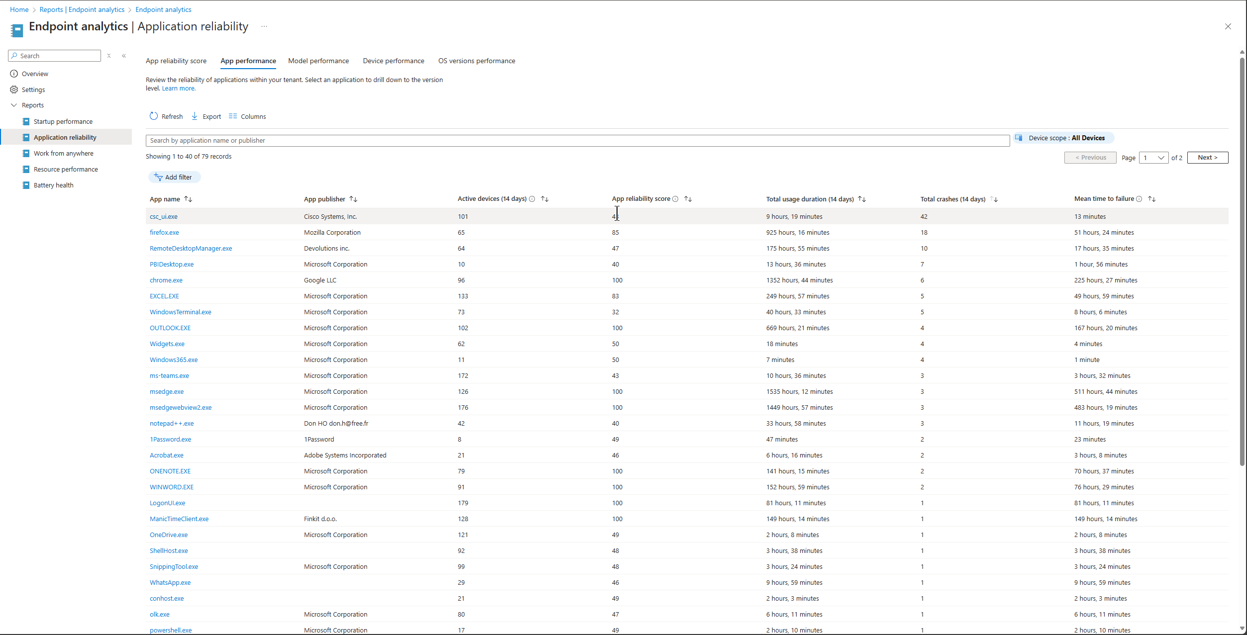
Enhanced Device Timeline

Slide 15
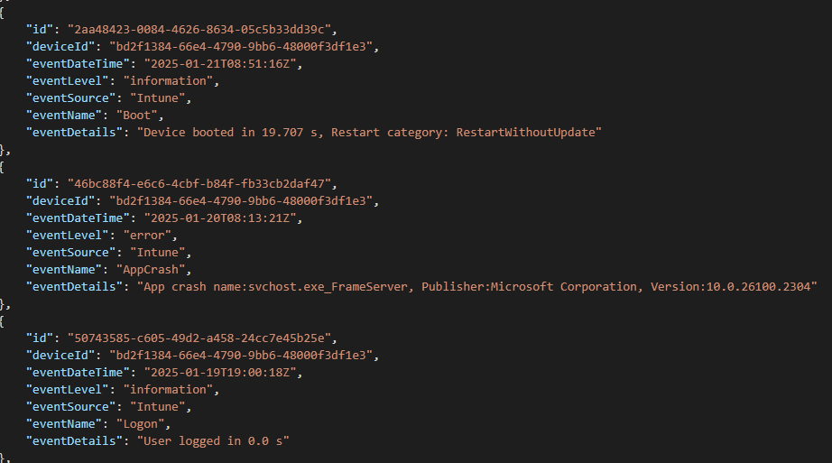
Enhanced Device Timeline Graph Api
https://graph.microsoft.com/beta/deviceManagement/userExperienceAnalyticsDeviceTimelineEvent/{userExperienceAnalyticsDeviceTimelineEventId}

Slide 16
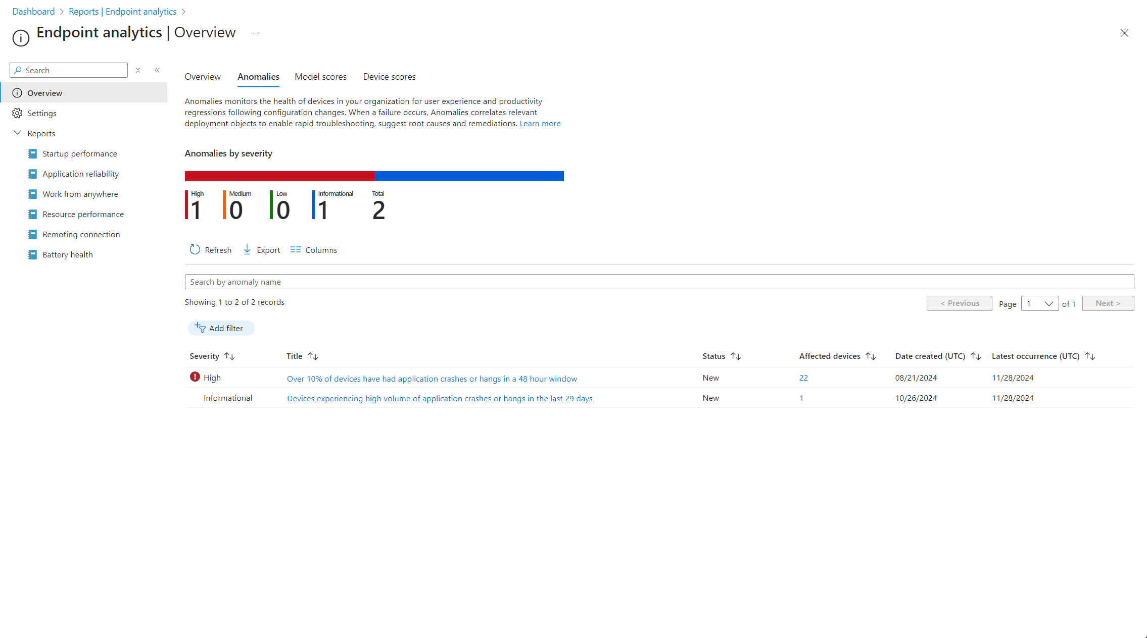
Anomaly Detection
Early Warning System for Device Issues
Proactive Identification of User Experience Regressions
Correlated Insights for Rapid Troubleshooting

Slide 17
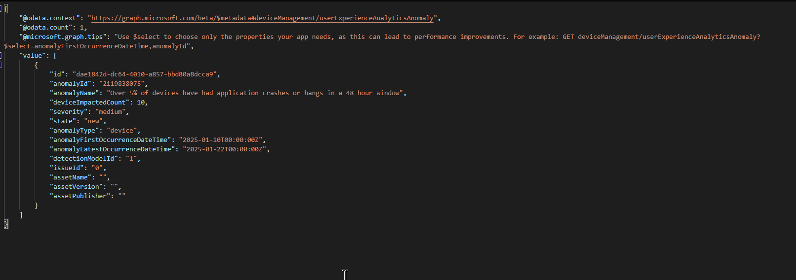
Anomaly Detection MS Graph API
https://graph.microsoft.com/beta/deviceManagement/userExperienceAnalyticsAnomaly

Slide 18
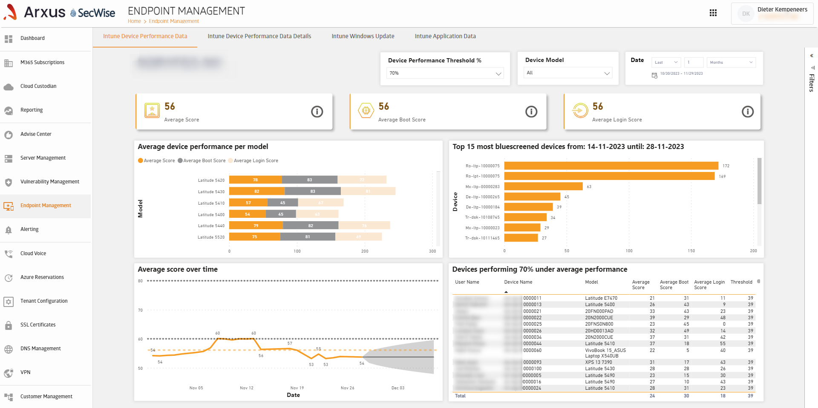
Create Your own Reports

Slide 19
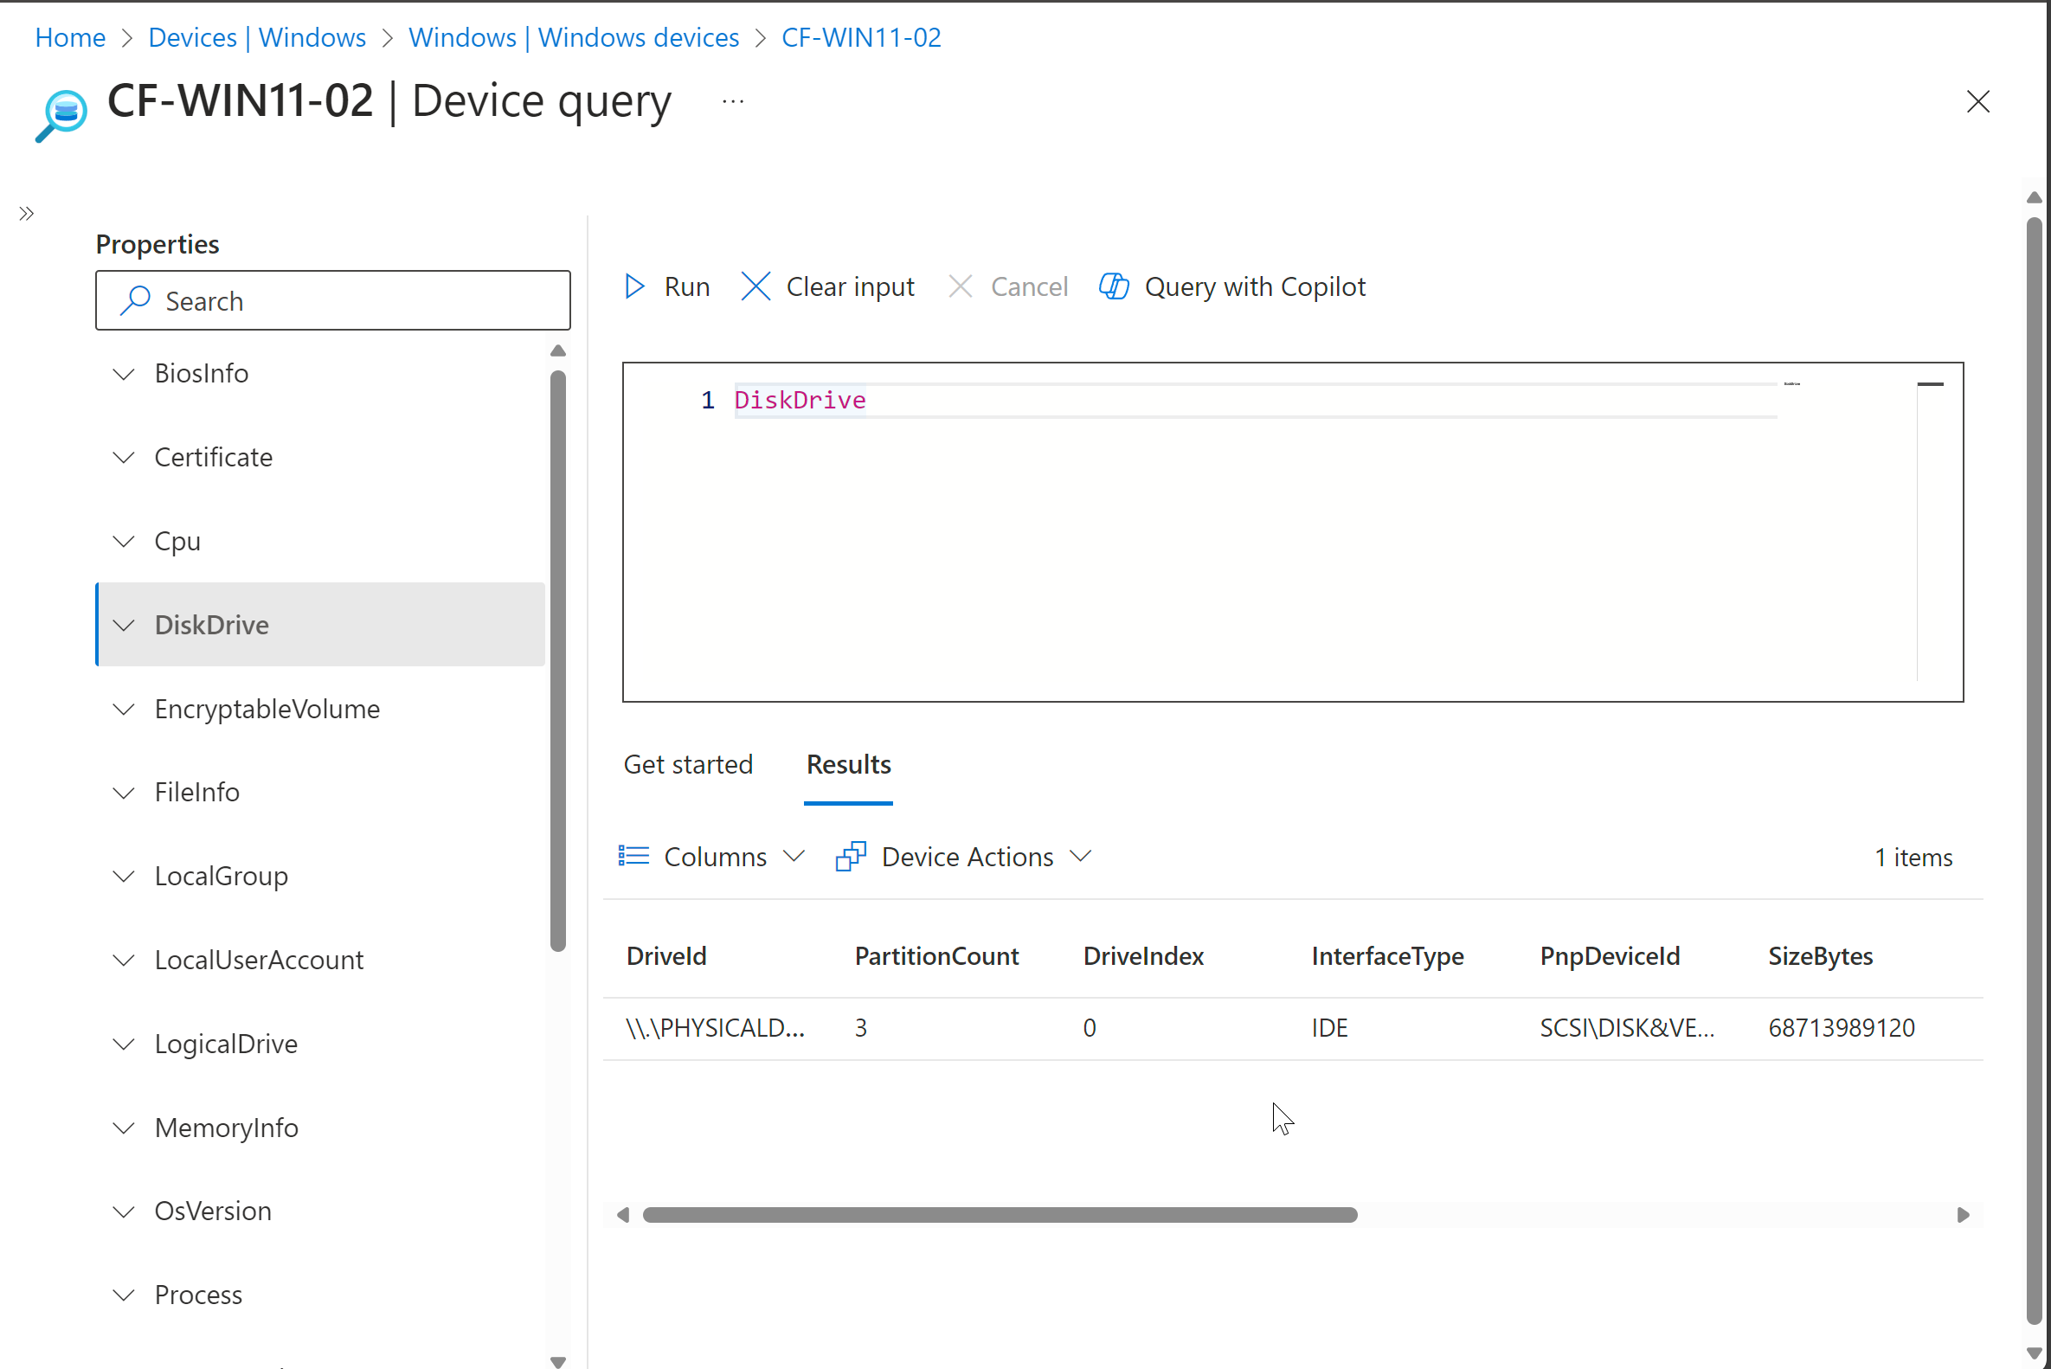
Device Query With Copilot
Real-Time Device Information Retrieval
Powerful Troubleshooting with KQL Integration
Remote Actions from a Single Interface
Enhanced Security and Compliance Monitoring

Slide 20
Code
Show Latest Application Installations
WindowsEvent('Application', 7d)
| where Message contains 'Installation completed successfully’
Show Services That Have Started
WindowsEvent('Application', 7d)
| where Message contains 'Service started’ Successful User Account Login
WindowsEvent('Security', 7d)
| where tostring(EventId) == '4624’
https://www.kqlsearch.com/devicequery

Slide 21


Please download and install the Slido app on all computers you use
Who has used Device Query
ⓘ Start presenting to display the poll results on this slide.

Slide 22
Please download and install the Slido app on all computers you use
Who has used it in combination with Copilot
ⓘ Start presenting to display the poll results on this slide.

